Slide 1
Decision Making with Data
The Leap to Advanced Analytics
OCTOBER 2025

Slide 2
NAVAL FACILITIES ENGINEERING SYSTEMS COMMAND
EXPEDITIONARY DIRECTORATE
“The major functions of the NAVFAC Expeditionary Directorate are to provide theater engagement (TE) and contingency engineering (CE) support to the deployed warfighter; develop and maintain the warfighter materiel allowance lists known as Tables of Allowances (TOA); conduct initial outfitting and total life-cycle systems management of the materiel solutions authorized in the TOAs; and support the operations of the Navy Expeditionary Combat Enterprise (NECE).” – Expeditionary Directorate Homepage
“Expeditionary Directorate provides oversight of the NAVFAC Engineering and Expeditionary Warfare Center (EXWC) Expeditionary Programs Office (ExPO) which is responsible for the initial outfitting, recapitalization and total life cycle systems management of the systems, equipment and material authorized for expeditionary TOAs.” - ExPO Mission Statement

Slide 3
Solidifying Vague Objectives
FANTASTIC FOUR
First Steps
How do we define success?
What are we optimizing?
What are the constraints?
What data do we have?

Slide 4
3M
Maintenance Material Management Data
3M Request
000001
UIC: ABC123
Vehicle SN: XYZ789
Request Type: 3
Parts:
1x N3456 $78.35
4x N5678 $375
Cost: $1578.35
Service Date: 10/01/2025
Job Completion Date: 10/05/2025
Notes: Replacing tires discovered pressure sensor was damaged.
“This system provides all maintenance and material managers throughout the Navy with a process for planning, acquiring, organizing, directing, controlling and evaluating the manpower and material resources used to support maintenance. As a management tool, the Ships' 3-M System provides efficient and uniform methods of conducting and recording preventive, alterative and corrective maintenance as well as allowing easy access to collected data.”
- Navy COOL

Slide 5
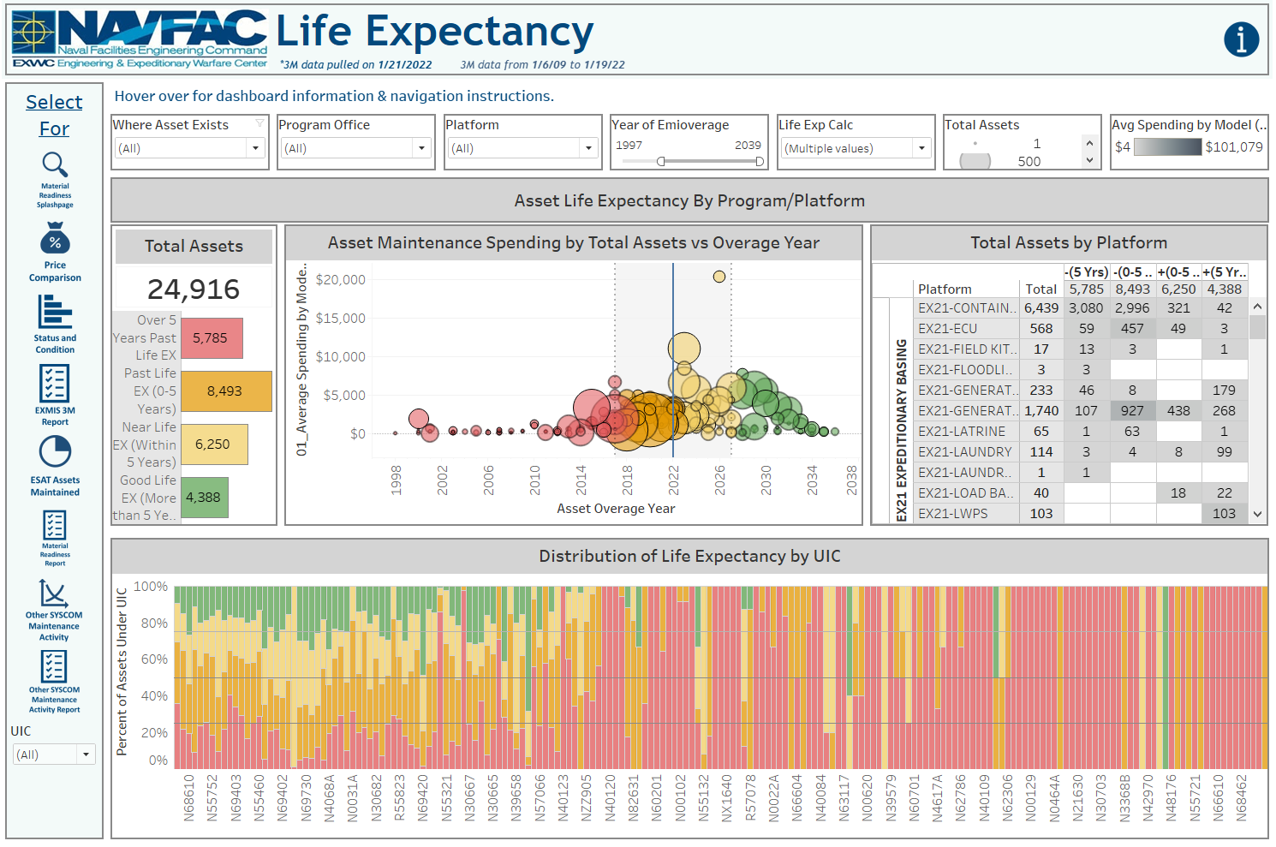
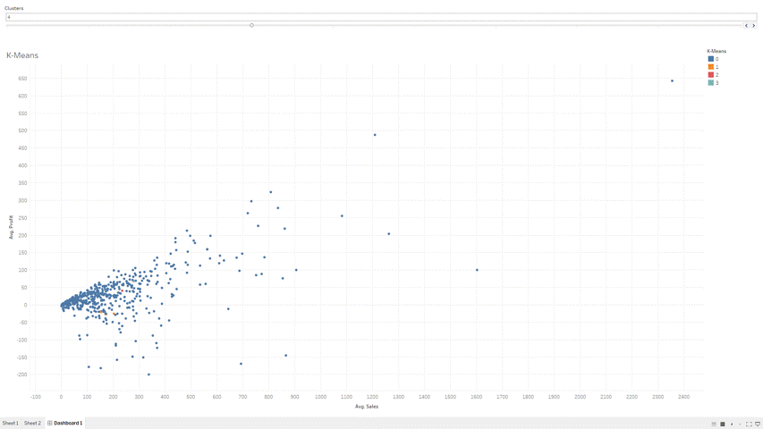


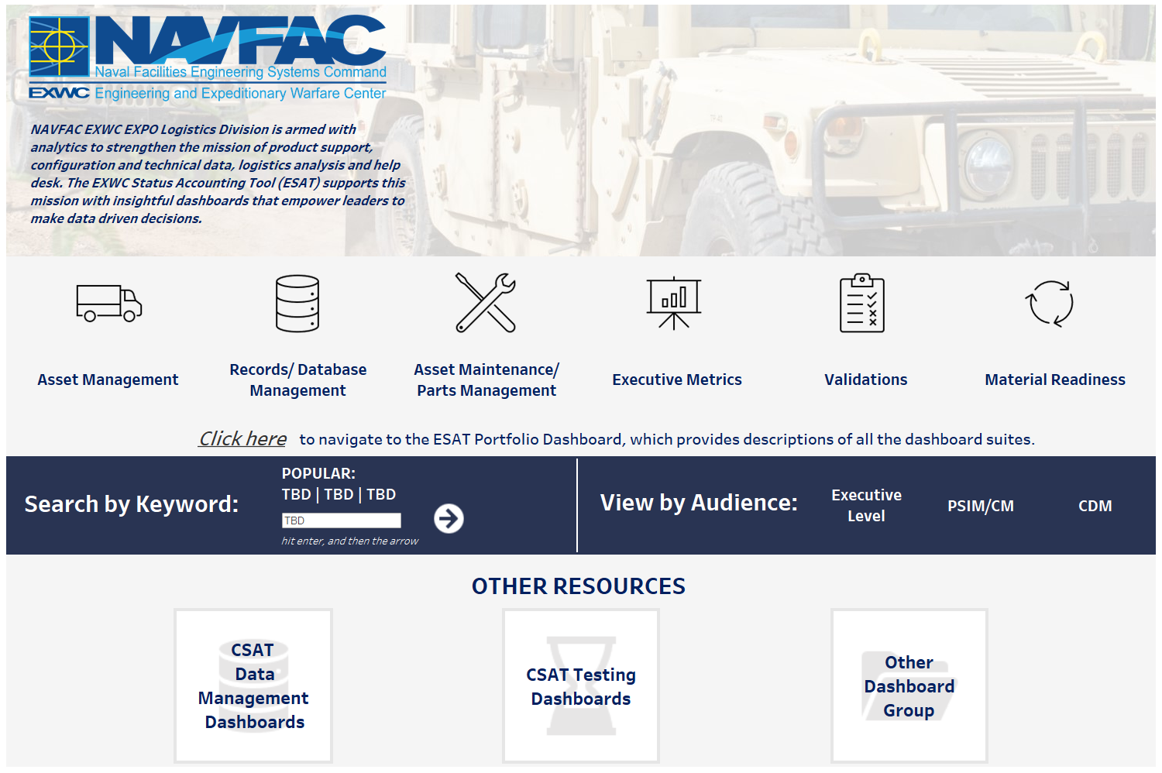

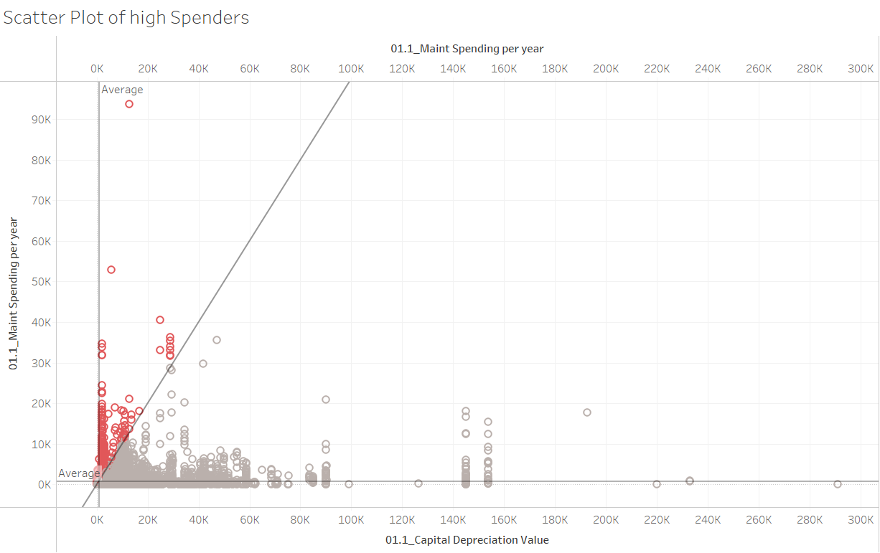
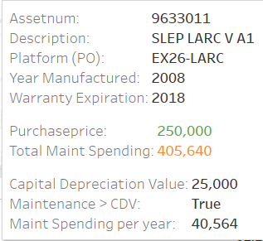
ExPO EX42 Data Science Use Case
1. Identify main objectives
Asset Lifecycle
Should we dermo an asset?
How many given parts should we stock?
TOA Whitespace
Bucketize assets based on risk levels
Part Predictions
4. Integrate models into Tableau to enable decision making
Use sliders and filters to adjust risk thresholds
Attrition Rate
High Failure
3. Develop and refine metrics using AI/ML and statistical inferencing
2. Evaluate existing data for suitability and alternative use cases
TOA Whitespace Space
Lead time
Identify major KPIs that help leaders make data driven decision on assets
Maintenance Spending
Past Warranty
Copyright © 2023 Booz Allen Hamilton Inc.
5

Slide 6
Garbage in, garbage out. Sure, but Apples in, Oranges out?
Feature | Primary Data | Secondary Data
Origin | Collected by the researcher for the specific study. | Collected by others for a different purpose.
Timeliness | Real-time and fresh. | May be outdated.
Relevance | Highly relevant and tailored to the study. | Relevance depends on the original purpose.
Cost & Time | High cost, significant time investment. | Low cost, quick to access.
Control | Researcher has full control over the data. | Researcher relies on the quality of existing sources.

Slide 7
3M Continued
Maintenance Material Management Data
3M Request
000001
UIC: ABC123
Vehicle SN: XYZ789
Request Type: 3
Parts:
1x N3456 $78.35
4x N5678 $375
Cost: $1578.35
Service Date: 10/01/2025
Job Completion Date: 10/05/2025
Notes: Replacing tires discovered pressure sensor was damaged.
Could this data be a reliable record of failures requiring maintenance downtime?
We learned that codes were used to indicate what type of event initiated the part order, and that all but one code indicated a failure.
We also learned that it was not uncommon for multiple orders to be lumped together and given a single code, and that two codes were often misattributed.
“Preventative Maintenance” and “Discovered During Preventative Maintenance”
The narratives input by the individual may be a way of classifying these records.
Bag of words.

Slide 8
Bag of Words
Performed
regular
maintenance
replacing
oil
and
rotating
tires
While
performing
regular
oil
maintenance
found
tires
need
replacing
1
1
1
1
1
1
1
0
0
0
1
1
1
1
1
1
0
1
1
1
Copyright © 2023 Booz Allen Hamilton Inc.
8

Slide 9
Multi-layer perceptron
Weights
N₁
1
W₁
1
1
W₂
N₂
T
1
W₃
Accept H₀
Input Layer
1
W₄
N₃
1
F
1
Reject H₀
0
N₄
Output Layer
0
0
Hidden Layer
Copyright © 2023 Booz Allen Hamilton Inc.
9

Slide 10
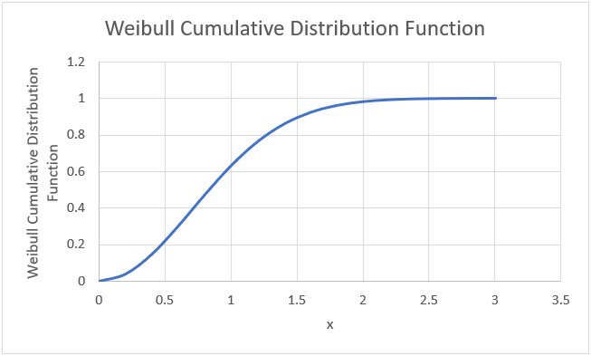
Predicting Failure
Statistical Inference
Weibull Cumulative Distribution Function
Now that “failures” are properly identified we calculate “suspense” times.
From the suspense times we fit a Weibull distribution.
We calculate the cumulative distribution function(s)
In Tableau, we offer user inputs for X and Y, such that the selected population has a probability greater than Y and a suspense less than X.

Slide 11
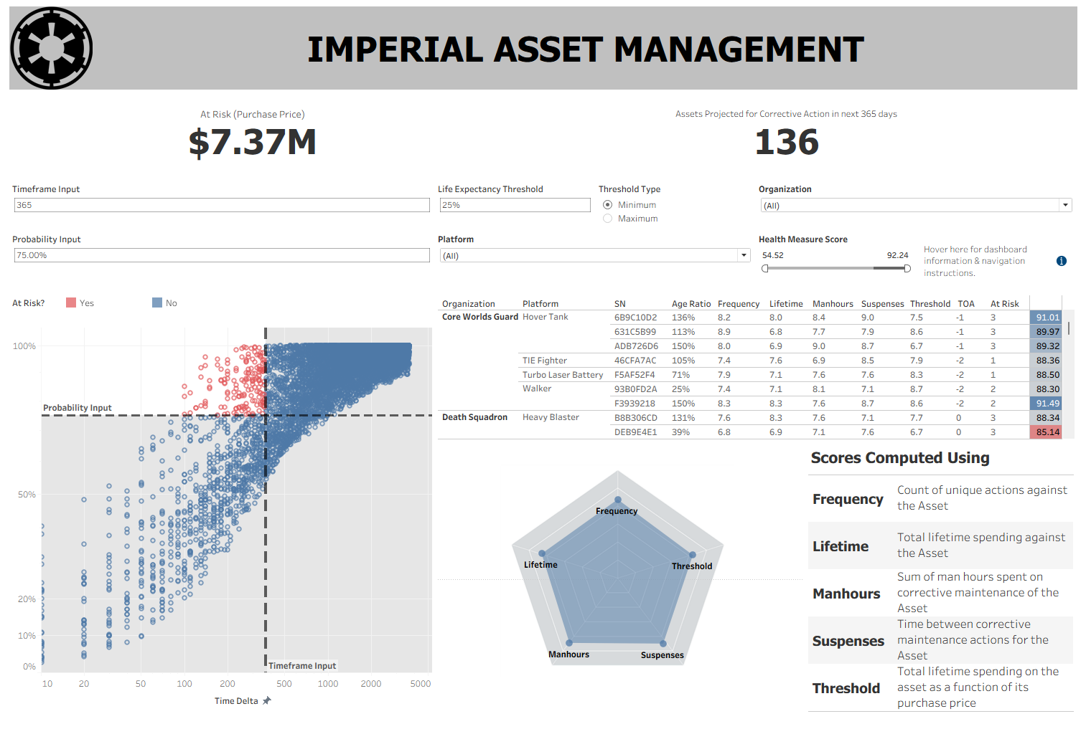
DASHBOARD DEMO

