Slide 1
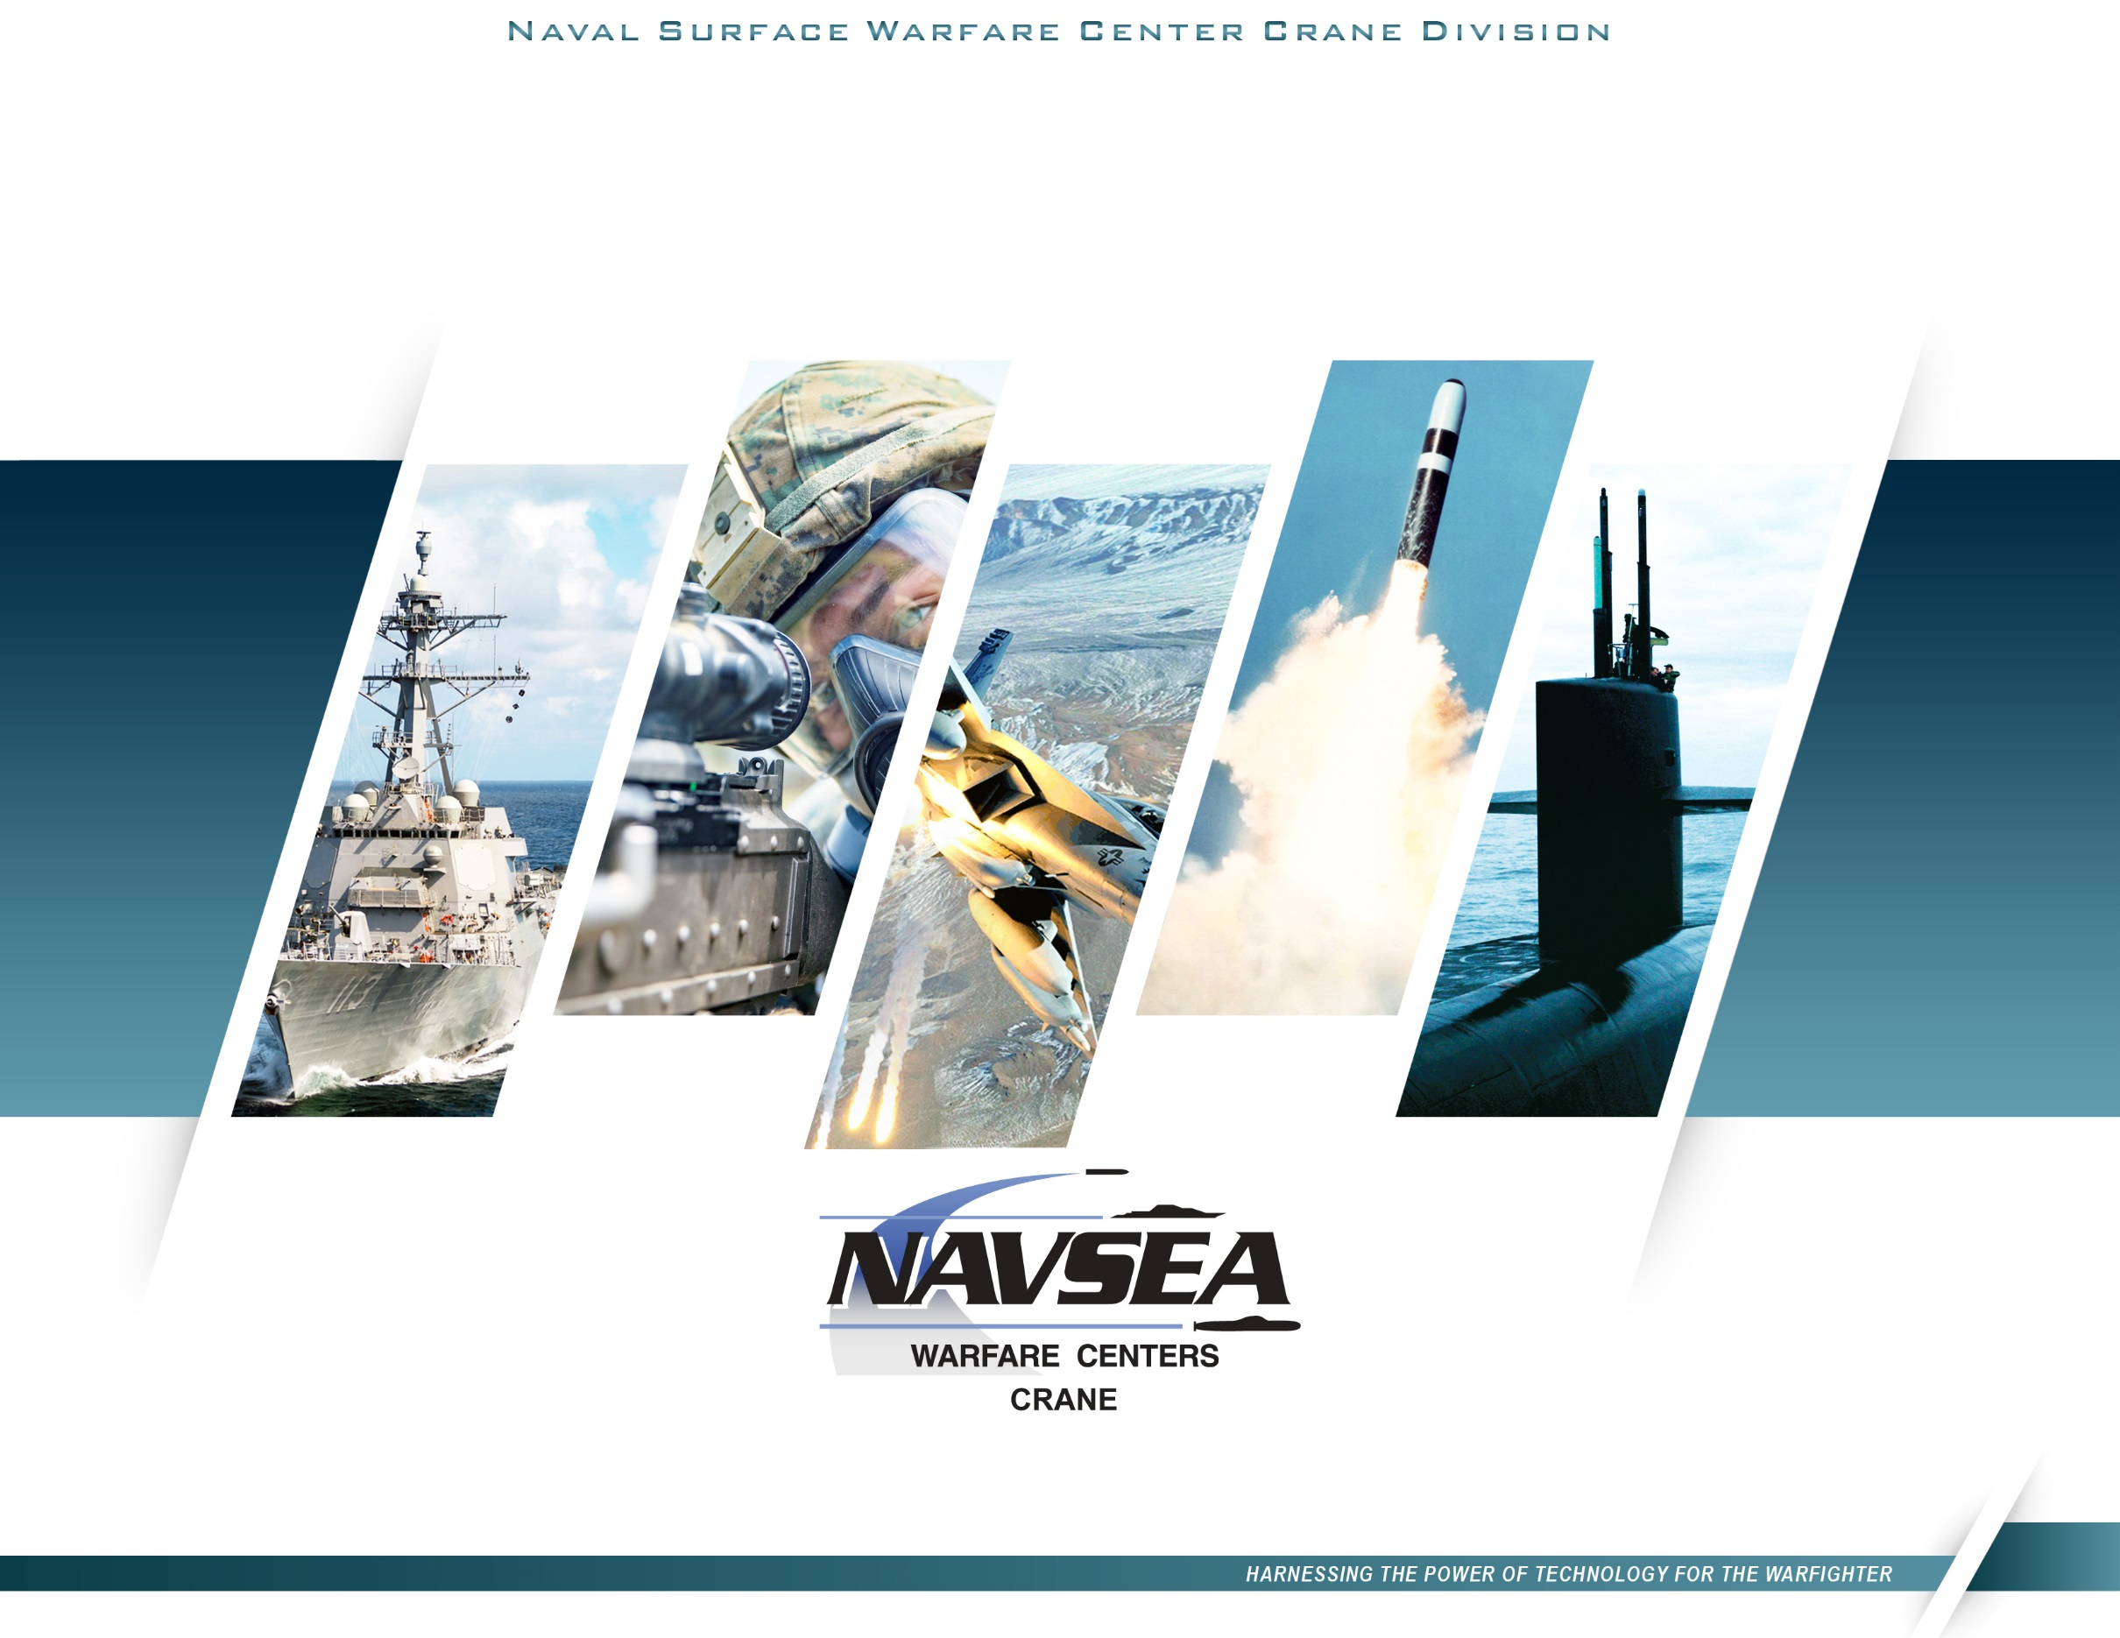
Midwest Defense Collaboration: Strengthening NSWC Crane’s Mission
CAPT Rex Boonyobhas, USN
Commanding Officer
Dr. Angela Lewis, SES
Technical Director
Statement A: Approved for Public Release; Distribution is unlimited.
Notes:
INTRODUCTION
It is an honor to be here with you all at this First Tuesday event here at Purdue@Westgate.
Every time I come here I am always in awe of the great work that occurs out here. I am glad to have our partners so close by and have enjoyed the long history of support from you all.
At NSWC Crane our primary mission is to support the warfighter. You all likely know that industry partnerships are critically important for us to be successful. Everyone here at Westgate plays a critical role in helping us make sure that goal comes to fruition.
We find ourselves at a critical juncture, our peer and near peer adversaries are inching ever closer and with it threatening global peace and US national security interests abroad.
Here is a video to give you a taste of what we do at NSWC Crane.
(SHOW VIDEO HERE for 2 minutes and 58 seconds)
*If the “Welcome to Crane” video does not get approved we will show the Navy hype video instead and replace this with our key mission areas and strategic priorities
Now that you know who we are, I want to tell you a little bit about how industry partnerships enable our support to our warfighters.

Slide 2

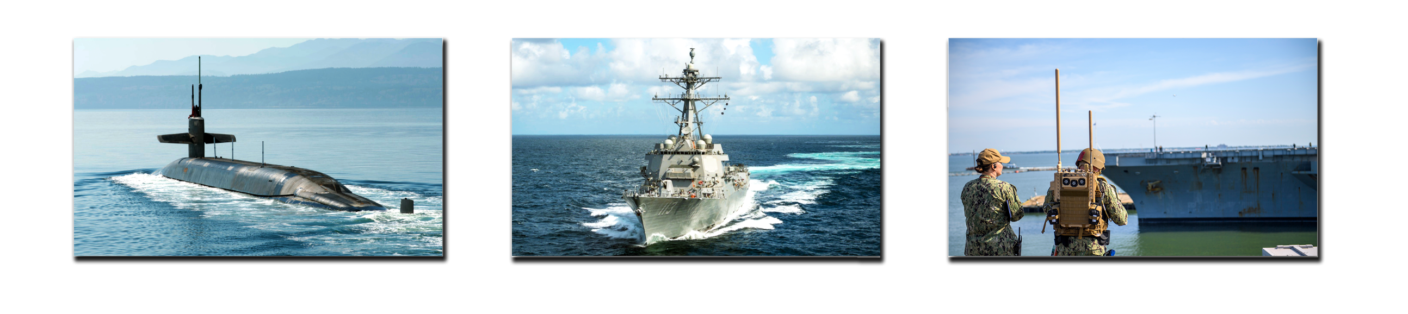
NSWC Crane Mission
Deliver innovative solutions and readiness to the NATION and its WARFIGHTERS.
Advance all-domain system of systems within the Mission Areas of:
Strategic Missions
Electromagnetic warfare
Expeditionary warfare
Statement A: Approved for Public Release; Distribution is unlimited.
Notes:
Criticality of Industry Partnerships
To maintain our edge, the Defense industries relationships with private industry is critical.
In order to deliver for our customers in the areas of Strategic Missions, Electromagnetic Warfare and Expeditionary Warfare, we cannot create innovative solutions in a vacuum.
Private industry enables the DoD to utilize outside expertise, find approaches that are “outside the box”, and challenge our notions of what developments we though were possible for the warfighter.
Broadly, our industry partners are a helped us become the military strength we are today. They have helped us create the most lethal military force on the planet, with technology that has kept our warfighters safe and mission ready.
The culture of innovation that is created when defense partners with industry is one we can see in action here at NSWC Crane.
NSWC Crane and Industry
At NSWC Crane we are at the forefront of the administration’s priorities and supporting critical weapons development.
Projects that are either directly supported or spearheaded at NSWC Crane are represented among the 17 priorities the current administration has for the DoD.
On these projects, we utilize the expertise and experience of our industry partners to fill in key support roles in everything from engineering and development, to administrative and tech support.

Slide 3














Innovation Ecosystem Model
Research Investments
Entrepreneurship
External Liaisons
Technology Transfer
Chief Technology
Office
Private Investments
Workforce Development
Academic
Partnerships
National Leadership Assignments
Engagement
Office
State & Local
Government Partnerships
Innovation Labs
The Midwest defense ecosystem: where collaboration fuels innovation, partnerships forge solutions, and the collective might of the region empowers the Warfighter like nowhere else.
Midwest Tech
Bridge
Notes:
The Greater Crane Ecosystem
The partnership between NSWC Crane and private industry has helped create the strong defense industrial base we have seen in this region.
Within the Indiana Uplands, the Defense industry is one of the leading economic sectors.
Defense permeates this area, with both small business and medium to large firms working with us at NSWC Crane.
The demand for our capabilities has never been greater
This can be demonstrated by the growth displayed at the Westgate tech park. Industry has come to this area bringing with it investment in the community, jobs for our residents, and a clear vision to aid our warfighters that matches the passions we hold at NSWC Crane.
The tech park currently has over 60 industry tenants and 500M in investment in new facilities within the park.
The passion to aid our warfighter binds us all. The result of our collective efforts is an ecosystem that stimulates economic growth within our area.
Public-Private Partnerships
New active projects with global companies in the ecosystem. Including: Prometheus Energetics, NHanced Semiconductors, Kratos, Amentum, Reliable MicroSystems, and CACI
Prometheus: 300M investment, primary partnership with Crane Army
Kratos: 50M investment, hypersonics payload integration facility
>25M invested by various companies into microelectronics capabilities within the park
Relevancy in Today’s Environment
Reiterate the criticality of Crane’s work
Despite the dynamic environment, demand for the products and services of NSWC Crane remains strong
Reiterate NSWC Crane tie to the Administration’s 17 priorities; majority of our workload maps directly to those priorities
As Congress looks to fund the Administration’s agenda while simultaneously working on the FY26 budgets, the priorities Congress and the Administration are looking to grow are those where Crane’s expertise will be critical
Our relevance cannot be overstated. And in order to deliver on the mission, we’re going to continue to lean on our partnerships with industry.

Slide 4
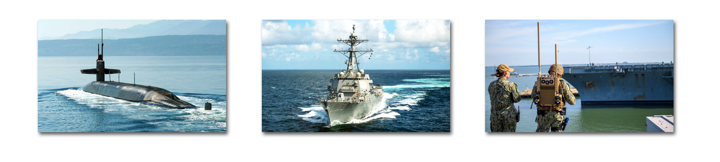
OUR MISSION & VISION
WHAT WE DO
Deliver innovative solutions and readiness to the Nation and its Warfighters
HOW WE DO IT
Advance all-domain system of systems within the Mission Areas of:
  Conduct science and technology, research, development, test and evaluation, acquisition and in-service engineering
STRATEGIC MISSIONS ELECTRONIC WARFARE EXPEDITIONARY WARFARE
V
ISION
  Combating our nation’s greatest threats, NSWC Crane is the
  indispensable mission expert, leveraging our deep technical heritage to
  deliver solutions through innovation and strategic partnerships
Notes:
Conclusion
As we've discussed, innovation doesn't happen in a vacuum. Our partnerships with industry are essential to developing cutting-edge technologies and maintaining our technological advantage.
Our industry partners help bring fresh perspectives, unique expertise, and the agility to push the boundaries of what's possible for our warfighters.
Across all three of our mission areas, we rely on our industry partners to provide essential support in engineering, development, technical expertise, and more
The expansion we see at Westgate Tech Park is a testament to the strength of this ecosystem and the shared commitment to supporting our warfighters.
This collaborative environment fosters innovation and strengthens our collective impact.
I encourage you to connect with our team and explore how you can become part of this dynamic ecosystem.
Together, we can ensure our warfighters maintain the unfair advantage they need to meet the challenges of an ever-changing global landscape.
Thank you again for your partnership and your commitment to national security.

